Slide 1

IST 722: Data Warehouse
FudgeInc Order Fulfillment
Group 2:
Kishan Polekar
Nandita Pathardikar
Prasun Abhishek Singh
Priyamvada Barve

Slide 2
The problem:
Delayed shipments causing order fulfillment inconsistencies.
The Goal:
Analyze various aspects of order fulfillment process to determine lag based on various factors.
Next steps:
Deliver insights and suggest possible solutions for lag reduction.

Slide 3

Functional Requirements:
1. What are customer trends based on specific orders / titles?
2. What type / category of products ships faster to customers?
3. How do different shippers fare in terms of delivery?
4. Is order fulfilment quicker for certain customers?
5. How soon are certain orders fulfilled (Lag time comparison)?

Slide 4
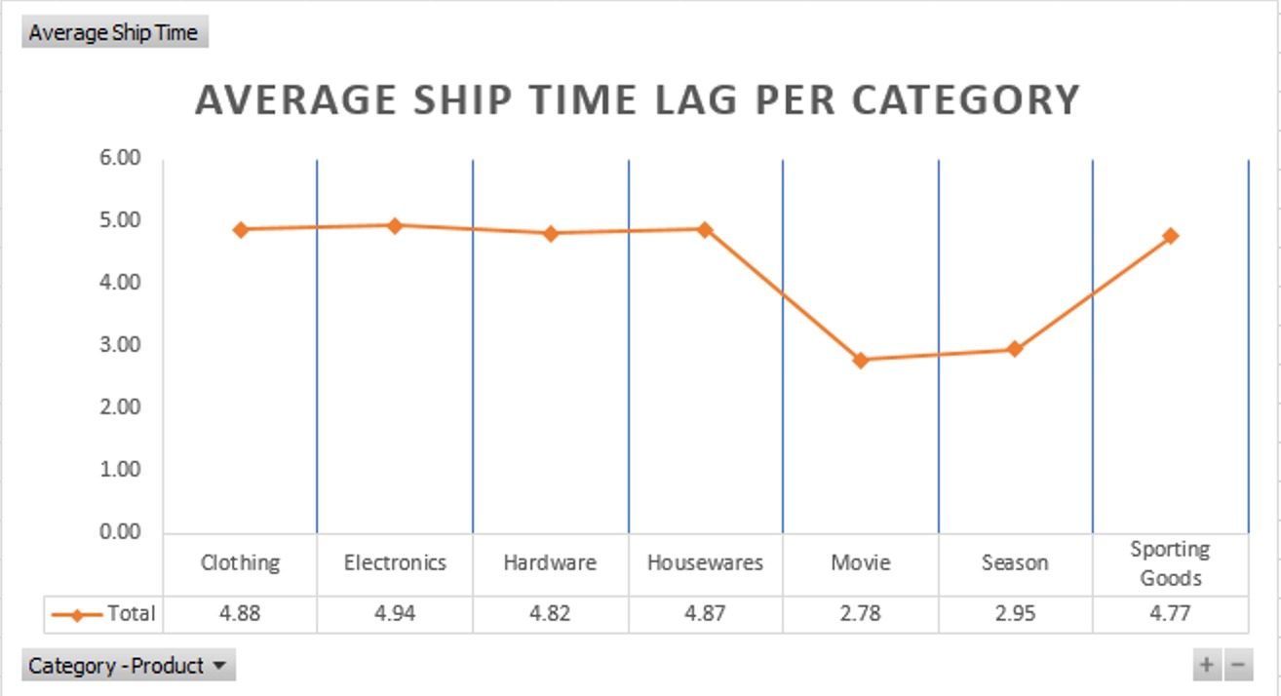
What is order fulfillment?
The heart of every business, to ship the given order on desired location in desired time is called order fulfillment.
This is calculated by the difference between ship date and order date.

Slide 5
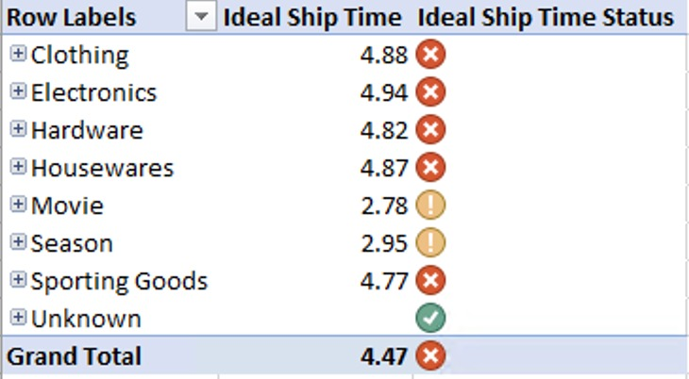
The Problem:
Our Problem is that the ship time for most of our segments is very long.

Slide 6
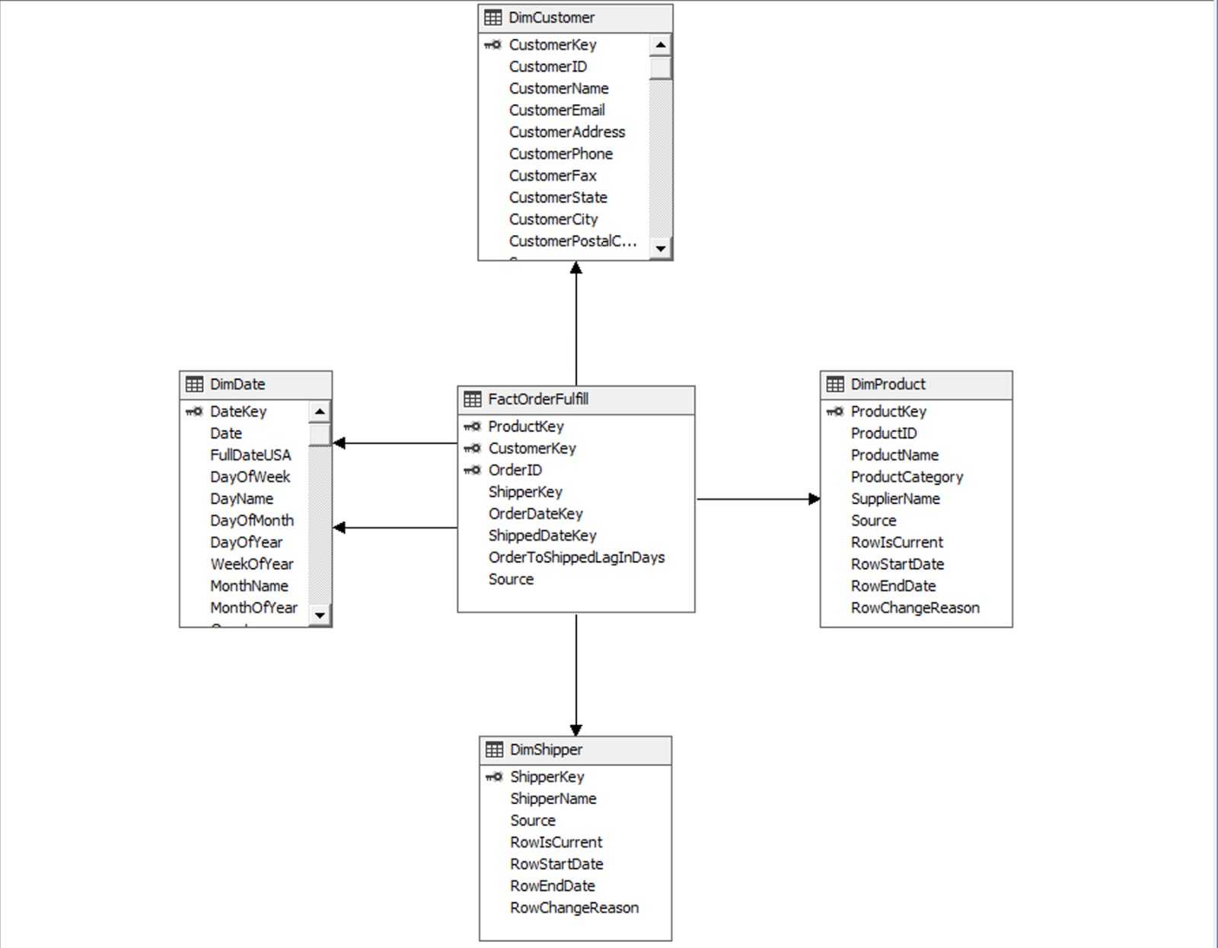
Star schema

Slide 7
Merger challenges
There were issues getting the right columns from both the companies since some data types were not compatible.
Trimming tables where possible to get only the data we need.
Figuring out which keys to use for the composite primary key for the fact table.
We were speculating whether to take Shipper in out analysis. We decided to go with it since we wanted to know which carrier provided better service and see which Shipper we would like to reconsider later.

Slide 8

Analysis using ROLAP and MOLAP

Slide 9
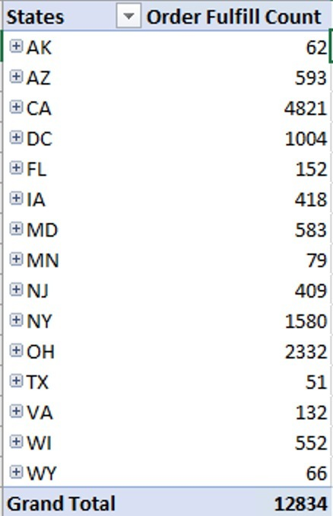
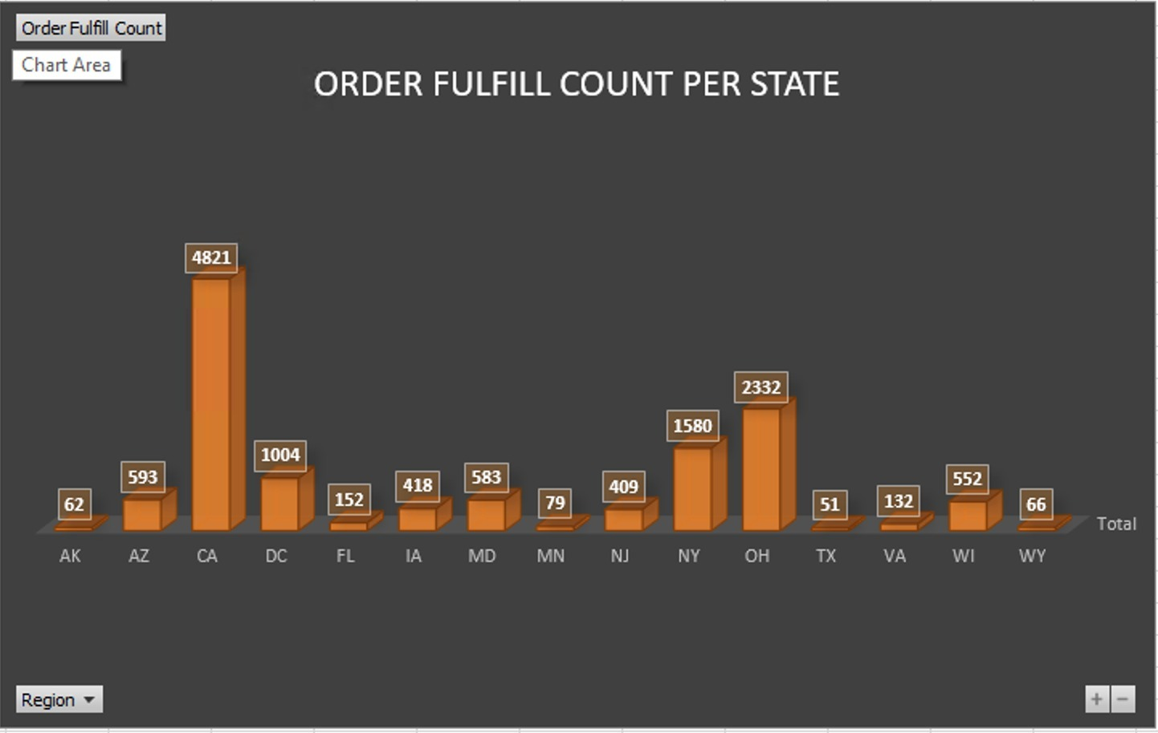
State wise Order Placement
Various economic, logistical, and regulatory factors within a country and its states can influence the lag time for order fulfillment

Slide 10
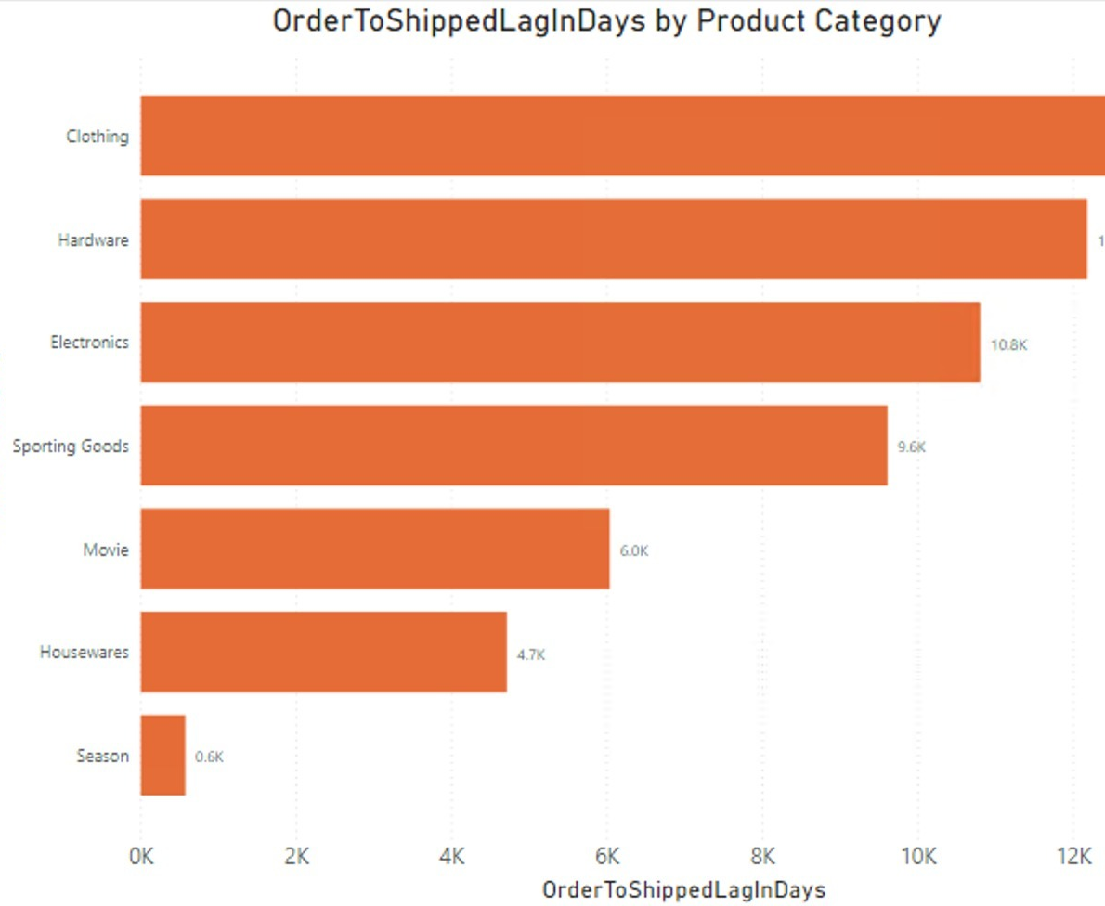
Lag time affected by Product Category
Different product categories may have distinct characteristics, handling requirements, availability, and processing complexities, all of which can influence the lag time

Slide 11
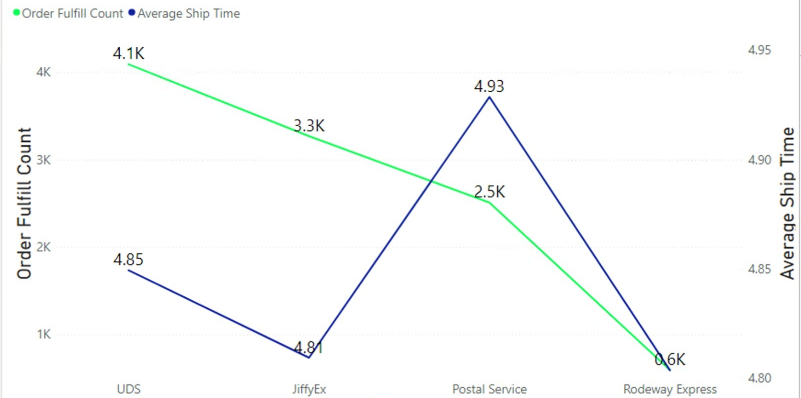
Order fulfillment Count and Time by Shipper
The choice of shipper and the effectiveness of their operations can influence the speed and reliability of order fulfillment.

Slide 12
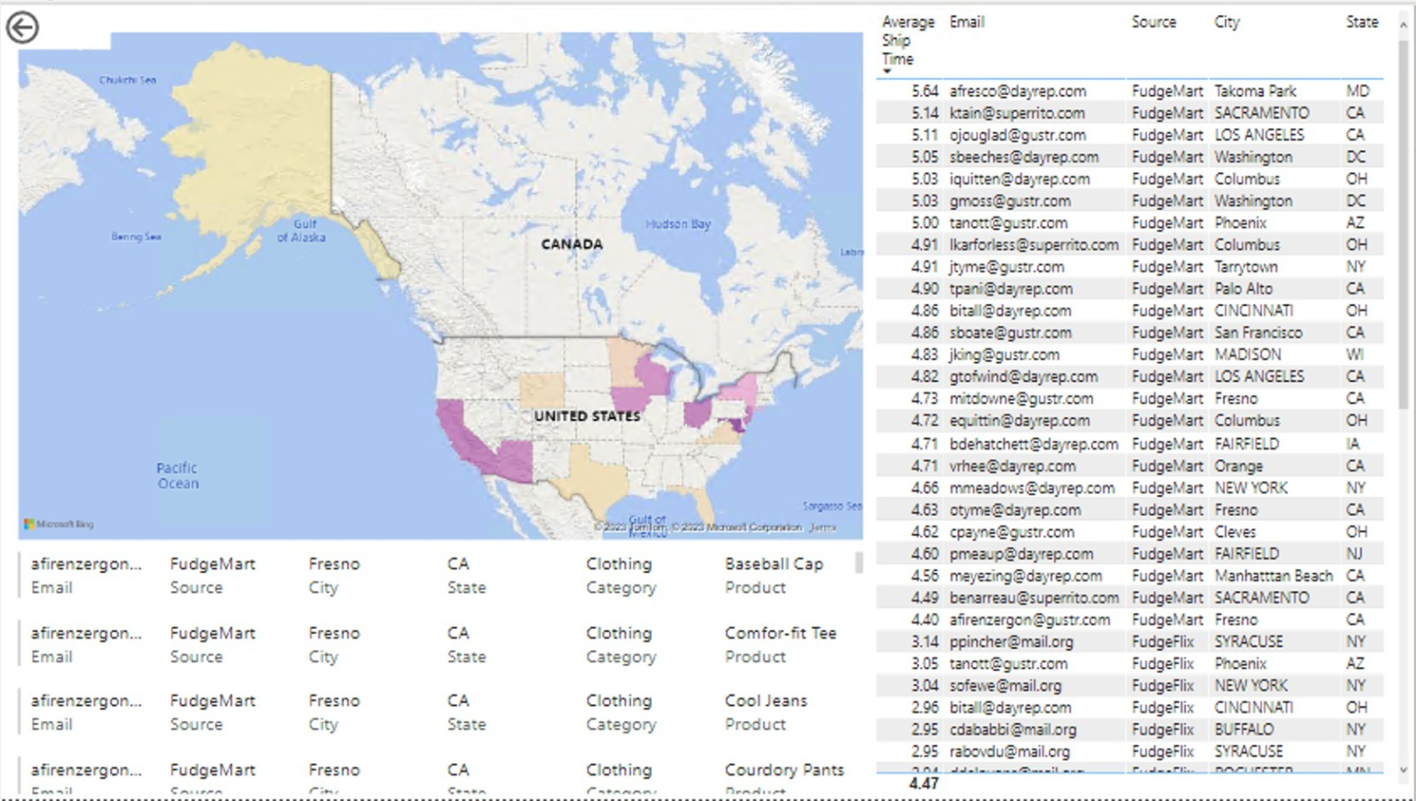
Lag time by Location and Customer
Different geographic locations, Local Delivery Infrastructure and types of customers introduce various logistical and operational considerations that influence lag time.

Slide 13
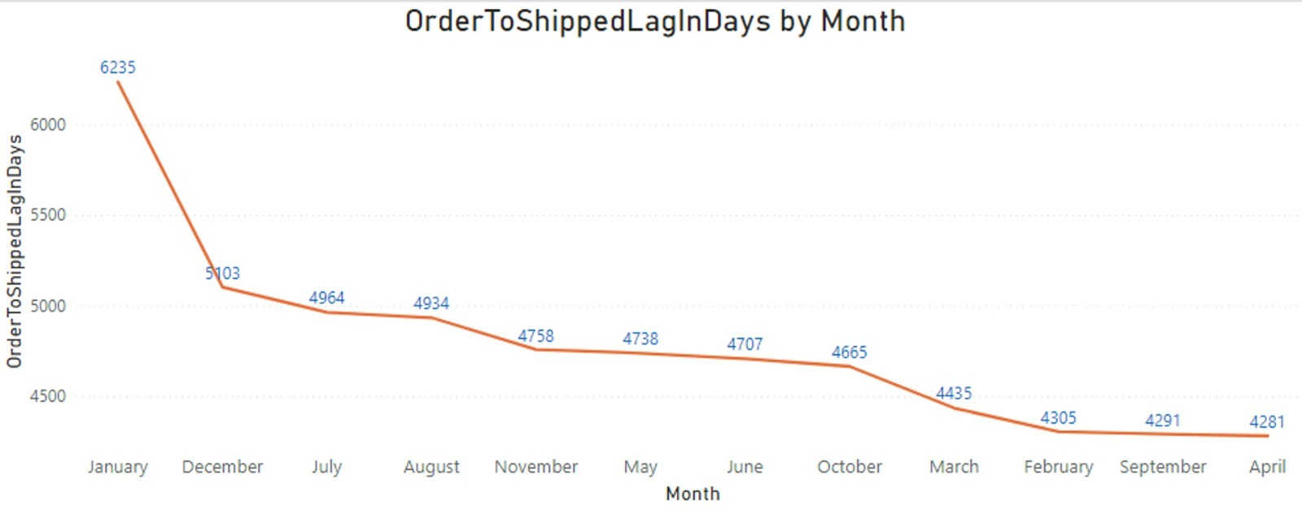
Lag time by month
Different months with Seasonal Demand Fluctuations, Holiday Rushes, Operational Capacity, Supplier and Manufacturer Schedules, etc impact order processing, fulfillment, and shipping times

Slide 14
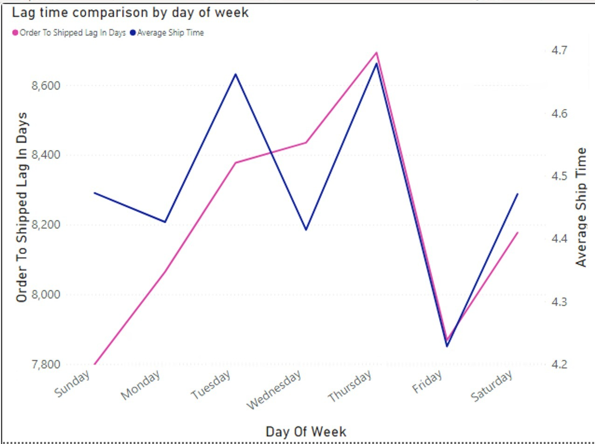
Lag time by Day of the week
Order Processing Backlog, Operational Staffing, Weekend Impact, Order Prioritization, Supplier and Partner Interaction etc can impact order processing, fulfillment, and shipping times for day of the week.

Slide 15
Recommendation : For shippers
Efficient Pickup and Delivery: Optimize pickup and delivery routes to minimize transit times and ensure timely deliveries.
Advanced Tracking and Notifications: Offer advanced tracking and timely notifications to customers, enabling them to plan for receipt and reducing delivery-related inquiries.
Carrier Partnerships: Collaborate with reliable carriers and establish strong partnerships to ensure consistent and efficient shipping services.

Slide 16
Recommendation : For Company
Optimize Inventory Management:
1
Maintain adequate inventory levels to prevent stockouts and backorders. Implement demand forecasting and reorder points to ensure products are available for timely fulfillment.
Streamline Order Processing:
2
Automate order processing workflows, minimize manual interventions, and use order management systems to expedite order processing steps.
Prioritize Order Fulfillment:
3
Implement intelligent order prioritization based on factors such as customer priority, shipping method, and product availability to ensure efficient order fulfillment.

Slide 17


